Slide 1
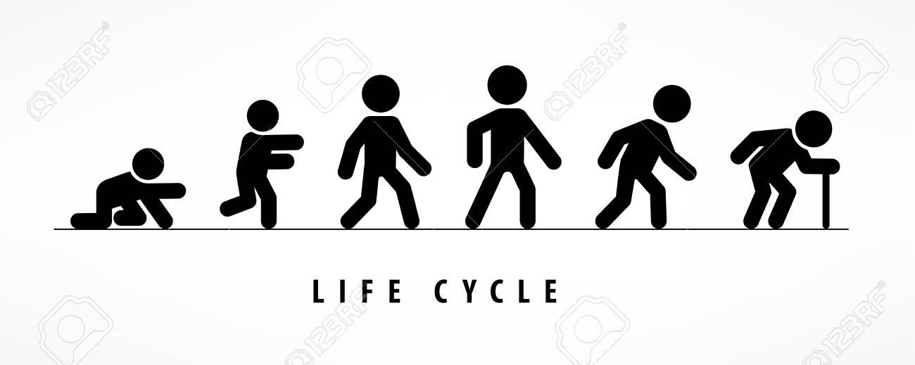
Project 3: Life Expectancy Trends Worldwide
University of Penn Data and Visualization Fall 2021
Cliff Ouma
Megan Williams

Slide 2
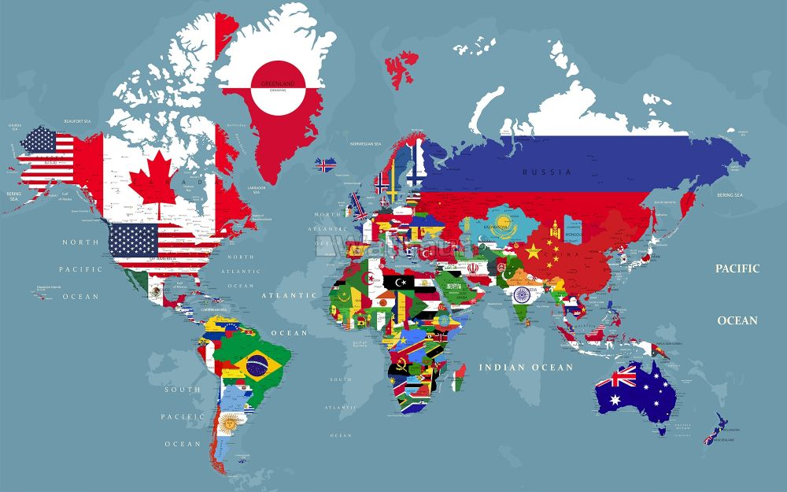
Average Life Expectancy Rates Worldwide
Idea
Take a lot of information and bring it together to create interesting visualizations that may show relationships
Biggest Limitation
There are too many variables that impact life expectancy to tell a complete story

Slide 3
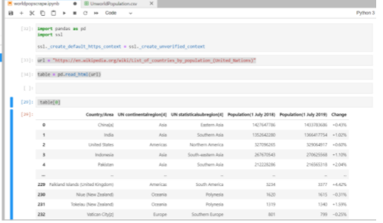
Data Sources
https://www.kaggle.com/daniboy370/world-data-by-country-2020?select=Urbanization+rate.csv
Ready to use data sets in CSV format
Includes data regarding
Life Expectancy
Fertility
GDP per capita
Meat consumption
Median Age
Population growth
Sex ratio
Suicide rate
Urbanization
https://en.wikipedia.org/wiki/List_of_countries_by_population_(United_Nations
We scraped Wikipedia for additional data to obtain
Population
Continental Region

Slide 4
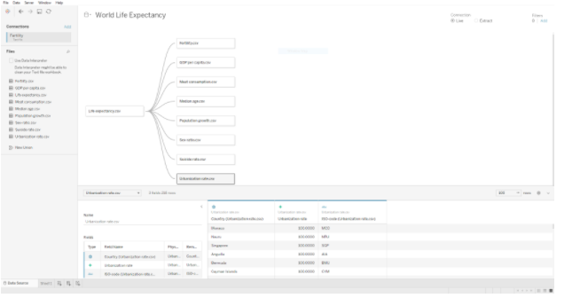
Loading Data into Tableau
After securing and cleaning our data sources we loaded them into Tableau and joined each source on ‘Country’

Slide 5
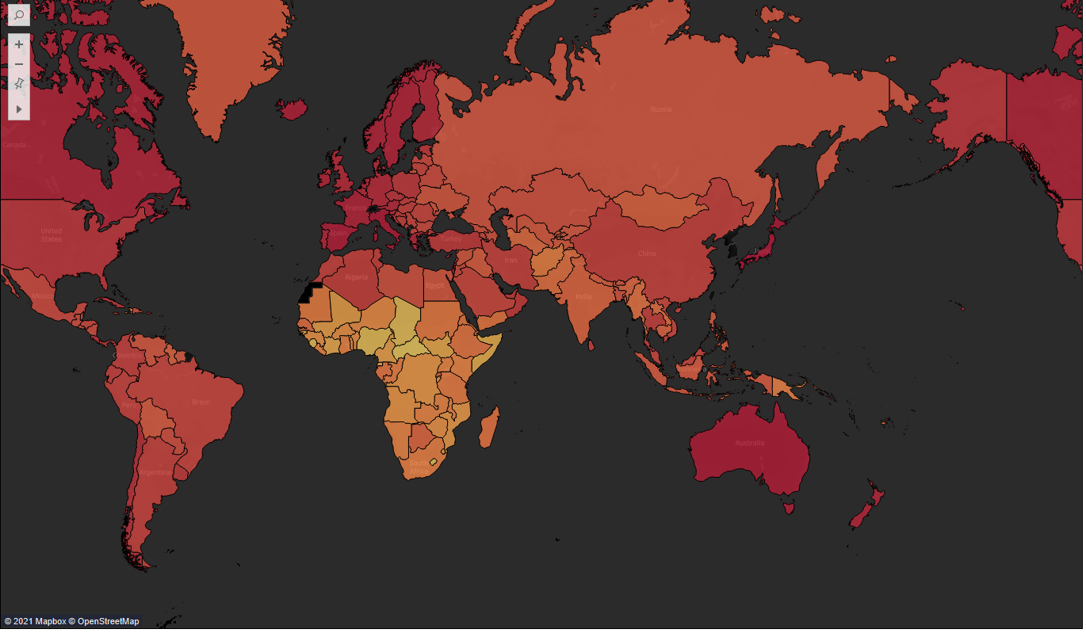
Final Story
Using the final data we created numerous visualizations to show relationships world wide between and among countries, continents and regions.

